Slide 1
CHED UPDATES, ISSUES AND CONCERNS
November 7, 2015

Slide 2
OUTLINE
CHED’s Programs, Projects and Updates, Issues and Concerns
Starting the school year right…some reminders

Slide 3
MANDATE
The Commission on Higher Education is mandated under R.A.7722 to:
promote quality education;
broaden access to higher education;
protect academic freedom for continuing intellectual growth; and ensure advancement of learning and research.

Slide 4
PROGRAMS AND PROJECTS
In line with the Administration's five Key Results Areas:
Anti-corruption/ transparent, accountable and participatory governance
Poverty reduction and empowerment of the poor
Rapid, equitable and sustained economic growth
Just, inclusive and lasting peace and the rule of law
Integrity of the environment/climate change mitigation and adaption

Slide 5
In support of anti-corruption/transparent, accountable and participatory governance
Tibay Edukasyon: Mediation, Fact-finding and Investigation of Violations of Laws, Rules and Regulations
Under this program, violation of laws, rules and regulations and other complaints are acted upon through mediation, conduct of fact-finding or investigations.

Slide 6
On poverty reduction and empowerment of the poor
HEI Research and Development (R&D) Programs
CHED supports the conduct of RDE aimed at generating, adapting and transferring or applying new knowledge and technologies for improving productivity and livelihood, promoting peace, empowering women, protecting the environment, reducing disaster devastation, and alleviating poverty.

Slide 7
CMOs related to research
CMO 3, Series of 2015, “Policy Reforms For The Grants-In-Aid Funds Of The Commission On Higher Education (CHED) For Research And Development, And Extension”
CMO 18 Series of 2015 “Guidelines for CHED Research Chair Award”
CMO 23, Series of 2014, “CHED Accredited Research Journals”
CMO No. 30 Series of 2010: Revised Guidelines for the CHED Best HEI Research Program

Slide 8
Research and Extension Program
Research
CHEDRO will monitor institutional research, on top of programs required research
All HEIs will be required to do tracer studies on:
Graduates
StuFAPs grantees
Extension Program
Butuan City Mayor gave full support to the Higher Education Institutions in Butuan City for the adoption of the Relocation Sites.
CHEDRO will monitor extension program of HEIs
CMO No. 8 s 2010 : Revised Guidelines for the Outstanding HEI Extension Award

Slide 9
Job-Skills Matching Program
In order to produce highly competent and competitive graduates, HEIs are encouraged to offer programs that are in demand and responsive to the needs of industry, both domestic and international.

Slide 10
Expanded Tertiary Education Equivalency and Accreditation Program (ETEEAP)
Skills and competencies acquired outside of the formal education system are evaluated and accredited towards earning a degree.
Deputized higher education institutions that shall award the appropriate college degree
Saint Joseph Institute of Technology (SJIT), the Only Deputized HEI in Caraga Region
Apply for Deputation, visit bit.ly/chedeteeap

Slide 11
Ladderized Education Program (LEP)
Allows recognition of units earned in technical vocational programs in TESDA.

Slide 12
Gender and Development (GAD) Program
CHED has actively and purposefully partnered with the Philippine Commission on Women (PCW) to maximize CHED's role in promoting the cause of gender equality and women empowerment.

Slide 13
GAD Budget provision mandated all government agencies and instrumentalities including local government units (LGUs) to allocate a minimum of five percent (5%) of their total appropriations for GAD programs and project.
Gender Mainstreaming and Monitoring System (GMMS)
CMO 01, S. 2015 - Mainstreaming of Gender and Development

Slide 14
Quality Assurance Programs
Setting and enforcement of Policies, Standards and Guidelines (PSGs) for academic programs, monitoring of compliance and phase out/closure of non compliant programs, Institutional Sustainability Assessment, and accreditation.

Slide 15
Typology of HEIs
A system of classifying HEIs based on their mandates and functions vis-a-vis national development goals. This typology will be harmonized with quality assurance criteria to allow HEIs to focus and excel within their respective classifications and be recognized for such excellence.

Slide 16
Curriculum Revisions
OBE – aligned curriculum should contain the following:
Program Outcomes
Curriculum Map
Program of Study
Summary of Courses
Course Specifications
Complete set of OBE-aligned syllabi
Submit one month before school opening, except for new OBE-aligned curriculum to be submitted June 2015
Submit to CHEDRO for CONTENT NOTATION

Slide 17
Deadlines for Initial Permits/ Renewal Permits/ Recognition/ Additional Majors
Initial Permits – June 30 of the year preceding the intended academic year of operation
Use GPR Checklist of documents, with payment P8,000
Letter of Intent is not accepted as application
Renewal Permits – June 30
Recognition – 1st working day of November of the school year prior to that for which recognition is sought
Additional Majors
Undergraduate - June 30
Graduate - June 30

Slide 18
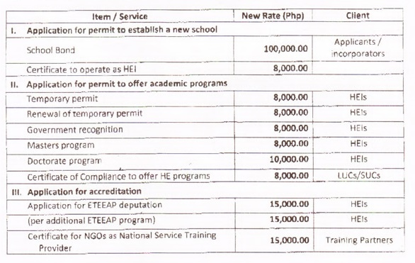
CHED New Rate of Fees, Charges and Assessments

Slide 19
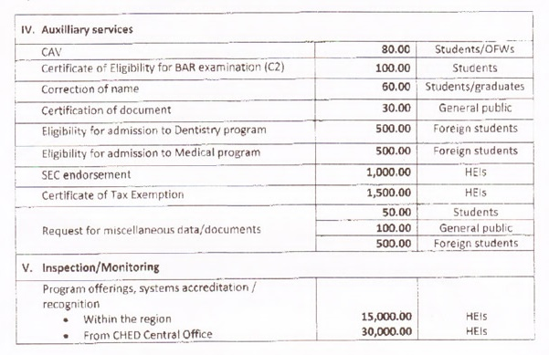
CHED New Rate of Fees, Charges and Assessments

Slide 20
Extension Programs/Classes
CMO No. 27 Series of 2009 – Guidelines Implementing Sec. 24 of the Manual of Regulations for Private Higher Education of 2008 Re: Establishment of Extension Classes/Academic Programs
Application is filed with the CHEDRO
Authority is issued by the Office of the CHED Chairperson

Slide 21
Program Accreditation
HEIs with programs that attain standards above the minimum are encouraged and assisted to have their programs evaluated by private accreditors or a recognized body, leading to the issuance of a certificate of accredited status.
There are eight (8) HEIs which programs are accredited to these agencies. In summary, the Region has only three (3) Accredited Level III Programs, 53 Level II Re-Accredited Programs, 21 Level I Accredited Programs, and 27 on Candidate Status, totalling to 104 programs.

Slide 22
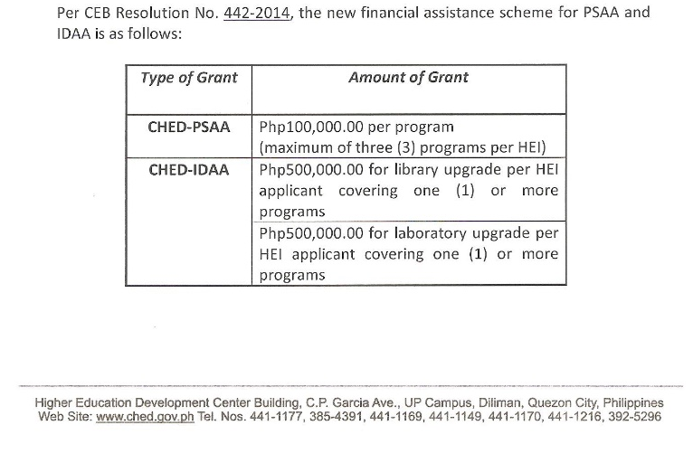
Accreditation Assistance
Preliminary Survey for Accreditation (PSAA)
Institutional Development Assistance for Accreditation (IDAA)

Slide 23
Institutional monitoring and evaluation
HEIs are monitored through Institutional Sustainability Assessment. This is a mechanism for monitoring and evaluating the outcomes of the programs, processes and services of HEIs in the key area of quality of teaching and learning as supported by the governance and management, student services, relations with the community, and management of resources.

Slide 24
Institutional Capacity Building
Centers of Excellence (COEs)/Centers of Development (CODs)
Faculty Development Program (FDP)

Slide 25
COE / COD
Current COEs / CODs are Extended until December 31, 2015
Applications for Renewal – April 30, 2015
CSU – COD for BS Math
FSUU – COE for Teacher Education
New Applications – May 15, 2015
CSU – Teacher Ed, BS Biology, ITE
PNU – Teacher Education
SDSSU – Teacher Education
SPUS – BS Criminology, BSBA
PNU – Teacher Education
For guidance, please refer to New CMO on COE/COE

Slide 26
HEI Management Development Program
Create awareness of the relationship between the quality of senior/middle-level management and the quality of HEIs performance.

Slide 27
Internationalization of Philippine Higher Education
CHED, in coordination with the Department of Foreign Affairs (DFA) strengthens international cooperation by joining international and regional bodies/ networks, negotiating and facilitating bilateral/multilateral agreements on academic cooperation and linkages of local HEIs with their counterparts in other countries as well as with international organizations.

Slide 28
CMO 19 Series of 2015 “Operational Guidelines for the Implementation of the ASEAN International Mobility of Students (AIMS) Program”
CMO 11, series of 2014, “Guidelines for Participation of Selected Higher Education Institutions (HEIs) in the ASEAN International Mobility for Students (AIMS) Program”

Slide 29
Practicum / OJT - Abroad
CMO No. 22, s. 2013 - Revised Policies, Standards and Guidelines (PSGs) on Student Internship Abroad Program (SIAP)
Participating HEIs must have Accreditation Level II, deregulated, CoE/COD or with ISA Classification A and B

Slide 30
Implications…
Quality and Quality Assurance

Slide 31
Why Quality Reform?
About 1800 HEIs of varying quality
Develop perspective of HEI:
Keep the end in mind
Develop internal QA systems

Slide 32
The Big Picture: NATIONAL IMPERATIVES
Improve the country’s competitiveness
Catch up with the economic development of our ASEAN neighbors
Enable Filipinos to compete with other ASEAN citizens even for Philippine-based jobs and overseas jobs in light of ASEAN 2015
Develop technological innovations and a large pool of competent workers to move up the value chain
Organize the education sector to make it more responsive to the country’s strategic development thrusts
Ensure the quality of educational institutions

Slide 33
The Big Picture: NATIONAL IMPERATIVES
Develop the Regions and Local Communities
Address the context-specific needs of different regions
Move Filipinos out of Poverty
Improve the poor’s access to quality education
Ensure the employability of graduates—i.e., a good match between the competencies learned in schools and those demanded by employers in the country’s diverse regional and ecological contexts

Slide 34
Quality in Higher Education
Quality as exceptional
Quality as perfection or consistency
Quality as fitness for purpose
Quality as value for money
Quality as transformation
There is alignment and consistency with the institution’s VMG, at exceptional levels, demonstrated by the learning outcomes and the development of a shared culture of quality
Harvey, L., Green, D. (1993), "Defining quality", Assessment and Evaluation in Higher Education, Vol. 18 No.1, pp.9-34.

Slide 35
Quality means doing it right when no one is looking.
Quality is not an act, it is a habit.
No compromise over Quality.

Slide 36
Quality Assurance
“Quality assurance is not about specifying the standards or specifications against which to measure or control quality. Quality assurance is about ensuring that there are mechanisms, procedures and processes in place to ensure that the desired quality, however defined and measured, is delivered.” (Church 1988)
Harvey, L., Green, D. (1993), "Defining quality", Assessment and Evaluation in Higher Education, Vol. 18 No.1, pp.9-34.
Church, C. H. (1988), “The qualities of validation”, Studies in Higher Education, 13, 27-43.

Slide 37
Starting the year right…some reminders

Slide 38
Tuition and Other School Fees
CMO No. 3, Series of 2012, “Enhanced Policies, Guidelines and Procedures Governing Increases in Tuition and Other School Fees, Introduction of New School Fees, and for Other Purposes”
CMO 8, Series of 2012, “Amendment on CMO No. 03, S. 2012…”
Notify CHEDRO at least 15 days before consultation
CHEDRO may attend (RMSTF – CHEDRO is required)
Submit requirements Not Later Than April 1, 2015
Regional Inflation Rate – 4.38% for 2015

Slide 39
Tuition and Other School Fees
HEIs that increased last AY are required to submit Report on Actual Utilization (form is available)
HEIs are required to post Rates of Tuition and Other School Fees in strategic locations
With or without increase, CHED requires HEIs that did not increase to submit a certification together with comparative schedule of TOSF

Slide 40
Student Affairs Services Educational Tours and Field Trips
CMO No. 17, s. 2012
Submit documents required, per Checklist – Annex A, at least 1 month before school opening
Violators may be subjected to sanctions per Article IX

Slide 41
School Calendar
Article XVII of the MORPHE -CMO 40 s2008
Academic Year shall consist of not less than 36 weeks, or 18 weeks a semester
Shall not be less than 200 days or 100 days each semester, exclusive of all holidays and registration days and class days suspended
HEIs opting to adopt school term other than the specified shall seek prior approval from the Commission
Any change in the prescribed school calendar shall require approval of the Commission

Slide 42
Request for Indorsement
CHED will endorse an activity based on relevance
No endorsement will be made for Fund Raising
Endorsement is “Voluntary Participation” unless it is mandated by law or standard/regulation
All requesting parties will be responsible for disseminating the information
CHED will post the indorsement at its regional website, www.chedcaraga.com

Slide 43
Facilities and Safety Requirements
Section 26 Article VI of MORPHE – “Institutional Sites and Buildings”
Annual Renewal of FIRE SAFETY INSPECTION CERTIFICATE (FSIC) with BFP
Certificate of Building Occupancy
Campus Security
Traffic
School Sanitation
Environmental Hygiene
Waste Disposal

Slide 44
USEFUL REFERENCES
CHED Websites
http://www.ched.gov.ph
http://www.chedcaraga.com

Slide 45
Quality Assurance
http://www.ched.gov.ph/index.php/issuances/other-issuance/quality-assurance/
Sample or Suggested Curricula for Undergraduate Programs in Different Disciplines Aligned to Outcomes-based Education
bit.ly/obecurricula

Slide 46
Contact us anytime…
CHED-HEDC, CSU Campus, Ampayon, Butuan City
Tel No. (085) 342.5253 / 342.7483 / 342.7765 (telefax)
chedcaraga@gmail.com

Slide 47
“Broad partnerships are the key to solving broad challenges..”
Thank you…

